Slide 1
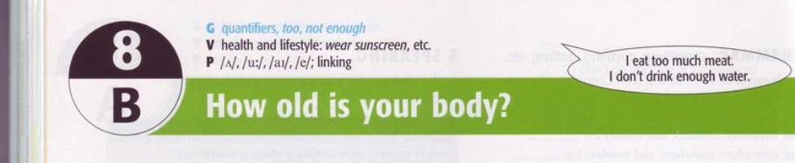
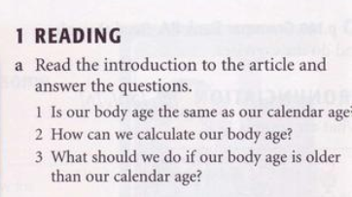
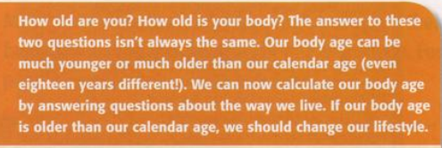

Slide 2
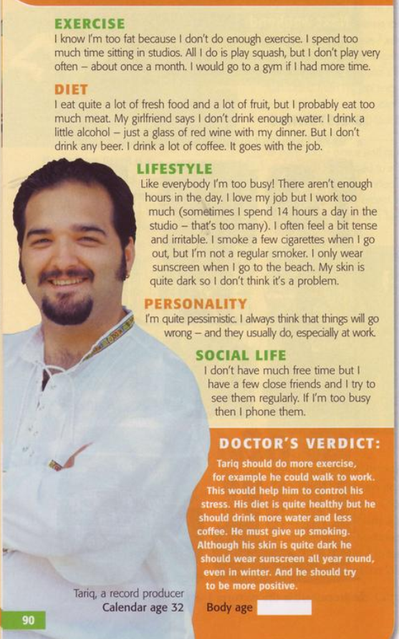
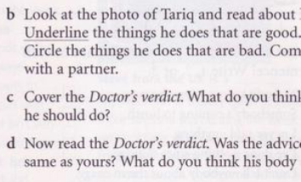

Slide 3
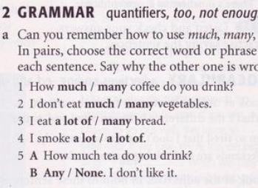
Grammar: Quantifiers, too, not enough

Slide 4
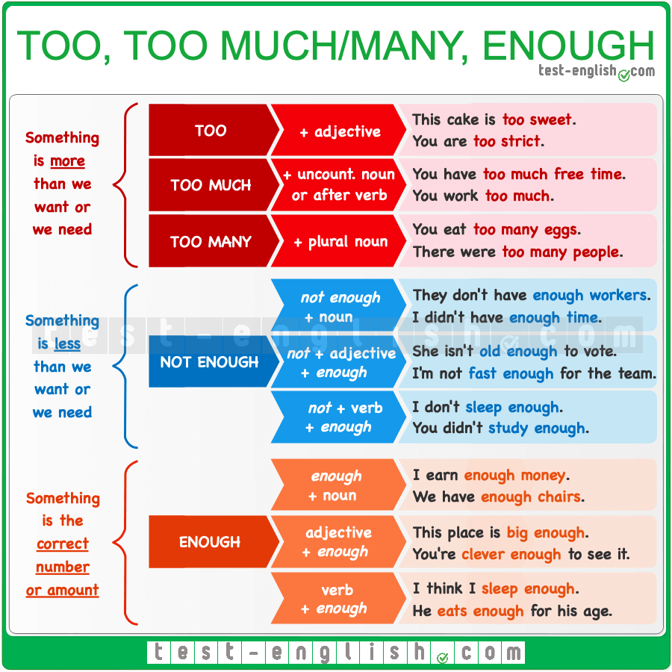
too, too much, too many, enough

Slide 5
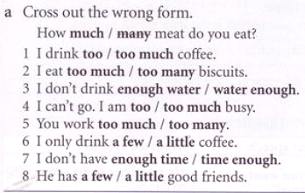
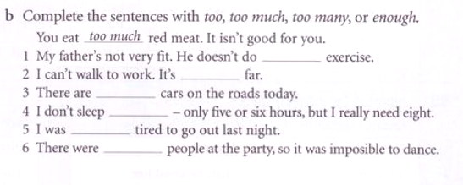
1 too | 5 too many
2 too much | 6 a few
3 water enough | 7 time enough
4 too much | 8 a little
1 enough | 4 enough
2 too | 5 too
3 too many | 6 too many

Slide 6
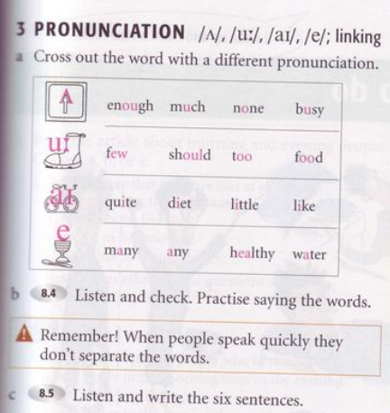

1. I don’t have enough time for exercise
2. I eat a lot of vegetables
3. I have only a few friends
4. I’m too busy to help you
5. We drink too much coffee
6. I have a little free time this afternoon

Slide 7
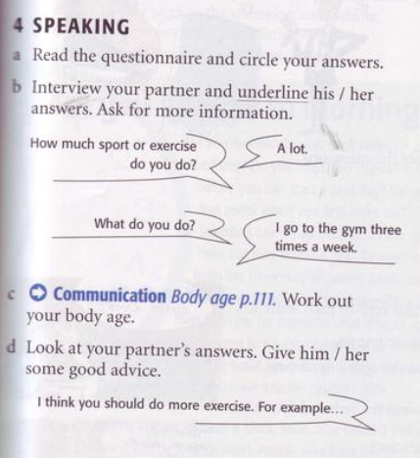

Slide 8
